Slide 1
Can Spark and HPC help find Dark Matter?
Saba Sehrish, Jim Kowalkowski
Demo at DOE Booth, Supercomputing 2016
Nov 16th, 2016

Slide 2
Goal
Can big data tools and High Performance Computing (HPC) resources benefit data- and compute-intensive statistical analyses in high energy physics (HEP) to improve time-to-physics?
We use Spark to implement an active Large Hadron Collider (LHC) analysis, searching for Dark Matter with the Compact Muon Solenoid (CMS) detector as our use case, and evaluate its performance on the supercomputing resources provided by National Energy Research Scientific Computing Center (NERSC).

Slide 3
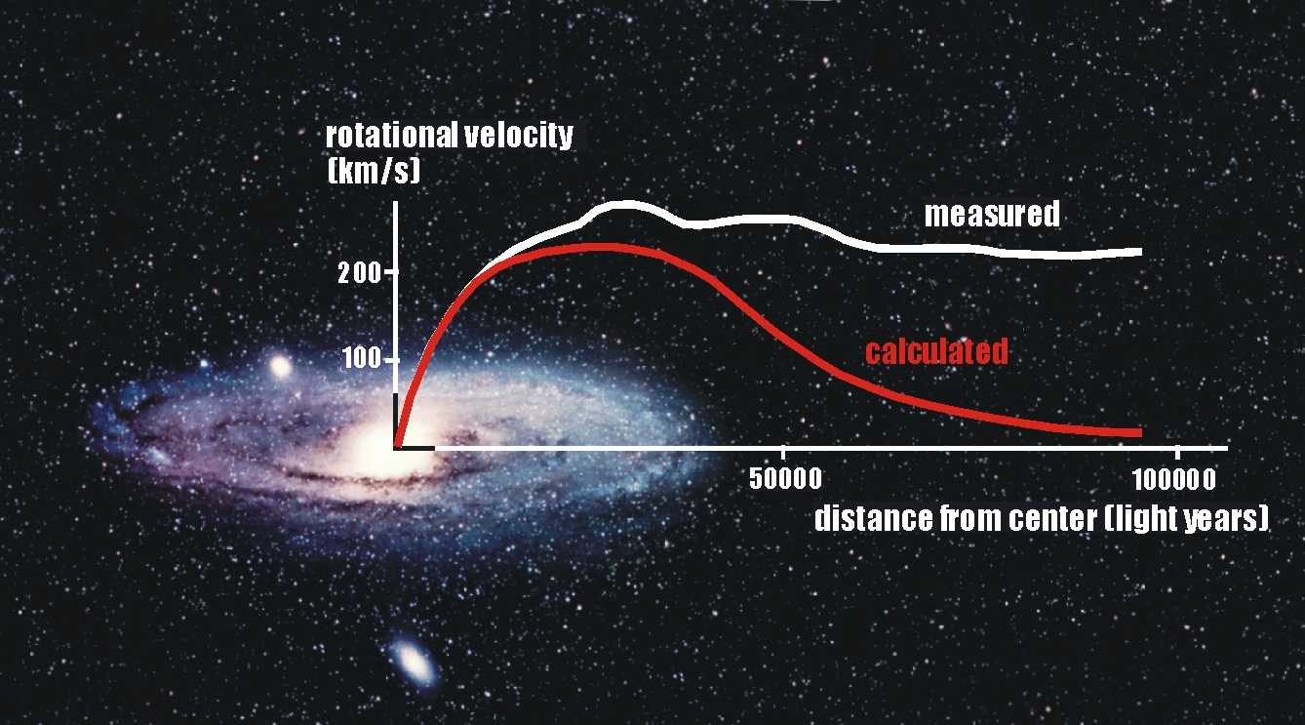
Physics use case: Search for Dark Matter
Notes:
Astronomers have observed many galaxies and have measured the speed at which stars rotate around the center of the galaxy
The white line shows how speed varies as the distance from the center of the galaxy
The red line shows the calculation based on the force of gravity that holds the galaxy together and based on the mass of visible stars.
The two don’t match, in order for them to match there is a lot of mass that we can’t see, that’s dark matter.
The most promising possibility is that Dark matter is previously un observed type of particle that interacts weakly. The CMS experiment and others are searching for direct evidence of these type of particles.

Slide 4
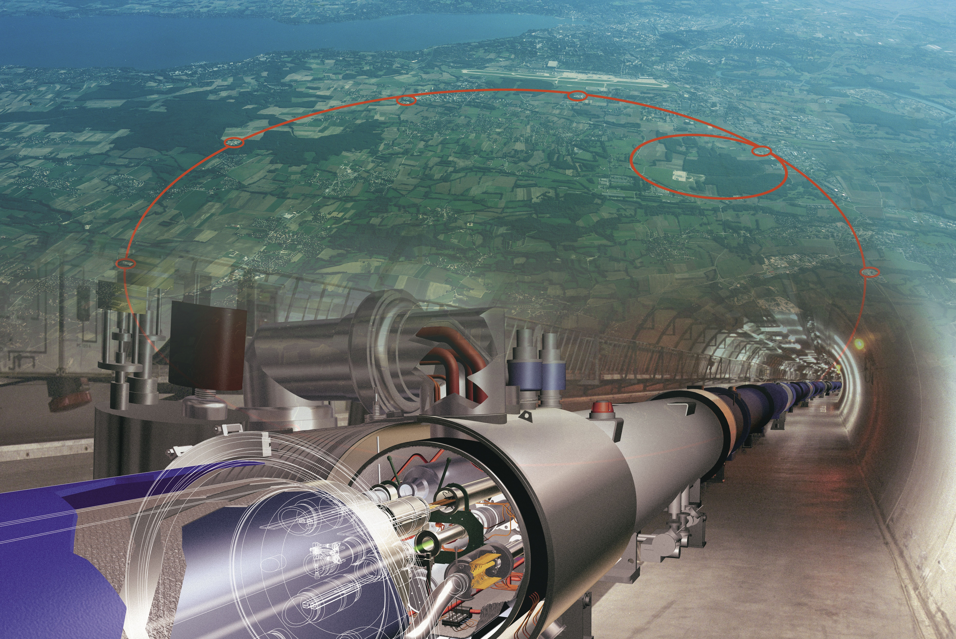
LHC (Large Hadron Collider) at CERN
Notes:
The LHC is the highest energy particle collider in the world, located in Geneva, Switzerland.
The beams of protons are brought to collision in four points around the almost 17 mile circumference ring.

Slide 5
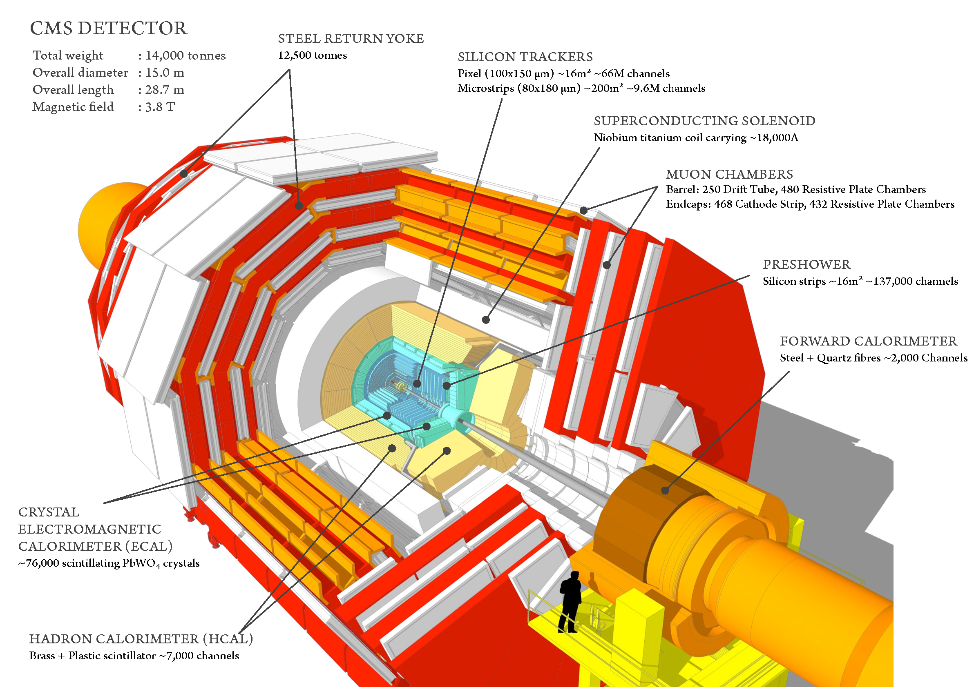
CMS (Compact Muon Solenoid) detector at LHC
Notes:
CMS is a particle detector that is designed to see a wide range of particles and phenomena produced in high-energy collisions in the LHC. Like a cylindrical onion, different layers of detectors measure the different particles, and use this key data to build up a picture of events at the heart of the collision.
Scientists then use this data to search for new phenomena that will help to answer questions such as: What is the Universe really made of and what forces act within it? And what gives everything substance? CMS will also measure the properties of previously discovered particles with unprecedented precision, and be on the lookout for completely new, unpredicted phenomena.
Took ~2000 scientists and engineers more than 20 years to design and build
Is 100 m underground at LHC
Weighs twice as much as the Eiffel Tower – about 14,000t

Slide 6
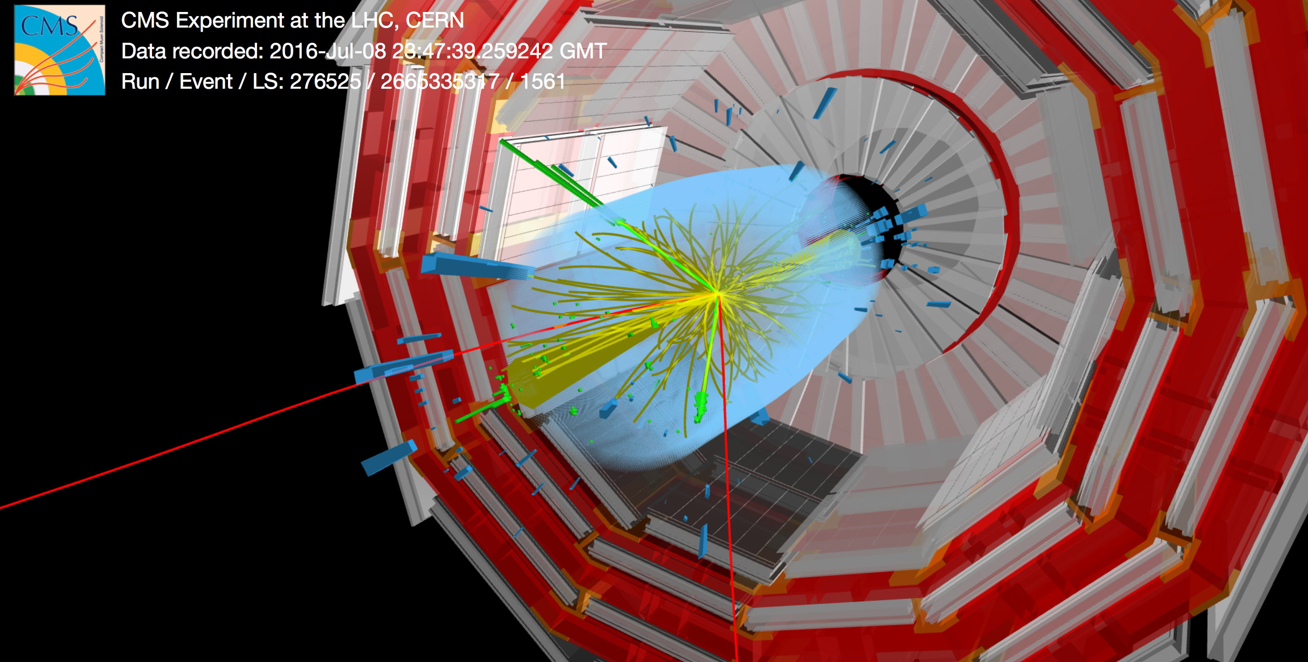
Particle collision example
Notes:
Tracks that are inferred in the detector, and identified as different particles. Hard to find electrons shown as light green lines, red are muons.
One collision like this is called an event, and are used in the analysis step to search for new particles

Slide 7
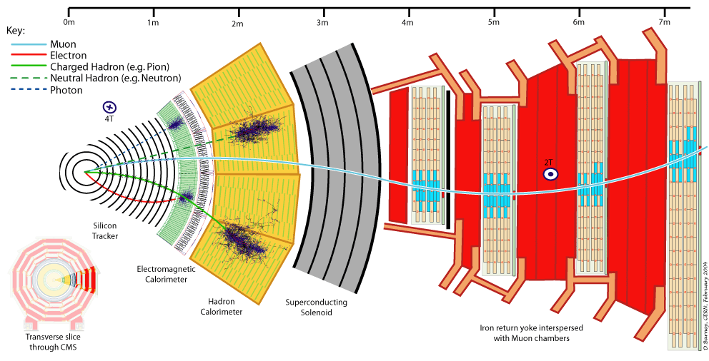
Different Particles as they get detected …
Notes:
Focus on Muon and Electron, Muon makes it through to the outer part of the detector. Electron gets absrbed in the green portion.
The amount of the curvature is direct measurement of the momentum. And along with the particle ID it tells how much energy this particle has.

Slide 8
Searching for new particles
Notes:
You need prediction of what the unknown particle looks like and also the prediction of how the known physics look like.
Looking for a higgs boson, it can produce 2 electons and two muons.
We will look for events that has 2 electrons and 2 muons, that will be one cut/filter.
If you assume that those 4 particles came from 1 particle, than the mass of that particle can be inferred.
Whats shown on this plot is a prediction form known physics what we would expect to see, the blue and green are two different sources from the known physics.
Points represent the observed data
Red line is the prediction what would a higgs boson with that particular mass looks like. That in combination with te background matches with the observed data.
To find new particles … restate first point.
Look for cuts to squish the background without squishing the signal.
Why you need big data => you need a lot of simulated events to be certain of the shape.

Slide 9
Current solution
Data Organization:
Data represented as rows that describe physics objects (particles) and the event in which they were seen
400kB/event and 5 x 10⁸ simulated events for backgrounds and signals
Data Processing:
Event-based processing, sequential file-based solution
Batch processing on distributed computing farms
28,000 CPU hours to generate 2 TB tabular data, ~1 day of processing to generate GBs of analysis ready tabular data, 5 – 30 minutes to run end-user analysis
Notes:
Apply cuts on each particle in an event, e.g. find one particle per event with maximum momentum and then filter all the events with particle flow MET greater than a certain value

Slide 10
Why Spark may be an attractive option
In-memory large-scale distributed processing
Resilient distributed datasets (RDDs)
Able to use parallel and distributed file system
Implement the algorithm using high level description in Scala, without worrying about task and data distribution
Data partitioning and task parallelism
Good for repeated analysis performed on the same large data sets

Slide 11
Our approach
Data organization:
We convert the data to column oriented format in HDF5.
HDF5 is a well-known format for the HPC systems; it also allows us to use non-big data technologies to process these files.
Read HDF5 files into multiple Spark DataFrames, one Spark DataFrame per particle type
Data processing
Define filtering operations on a DataFrame as a whole instead of an event.
Data is loaded once in memory and processed several times.
Make plots, repeat as needed.

Slide 12
Strategies to convert data
The conversion from CMS tabular format follows a straightforward pattern to represent each particle in an event as an HDF5 group, and each property of the particle as an HDF5 dataset within the group.
Number of HDF5 groups and datasets
One HDF5 group with compound datasets, one compound type per particle type
Multiple HDF5 groups per particle type, and multiple 1D datasets per particle property with in a group
Multiple HDF5 groups per particle type, and multiple nD datasets per particle properties grouped based on same data type
Column-oriented data for faster access
Number of HDF5 files
One HDF5 file for each original file
One HDF5 file for a group of similar simulation types
One HDF5 file per particle type
One HDF5 file for all the event data
Notes:
For example, one HDF5 group per particle type (Tau, electron, Muon) and one HDF5 dataset per particle property in each group e.g. momentum, trajectory

Slide 13
Custom HDF5 reader in action
HDF5 Group
RDD[Rows]
DataFrame
One chunk
Task 1
HDF5 Dataset
Task 2
Task 3

Slide 14
Encoding problem in Spark
Use Apache Spark 2.0 DataFrame API in Scala
Operating on multiple DataFrames, define operations for the DataFrame as a whole and often join a couple of DataFrames
Use filter transformation defined by computation on multiple columns
Implement the functionality using User-defined Functions (UDF)
UDF is a feature of Spark SQL to define new column based functions
Spark doesn’t attempt to optimize UDF
Use SQL select queries to join columns from different DataFrames
Use groupBy and aggregations (count, sum) to apply on the grouped data
Notes:
Whether RDD would perform better?
Complex queries to filter and join DataFrames as needed, for example, for each event count how many muons are there per event, find the muon with maximum momentum, check 10 more fields and filter…

Slide 15
DataFrames Organization
Muons
Event Info
Event | pt | eta
1 | 0.034 | 10.5
1 | 0.045 | 7.8
1 | -0.92 | 7.6
2 | 1.0 | 10.9
2 | 0.54 | 11.0
Event | Lumi | Weight
1 | 3245 | 0.5
2 | 3444 | 0.65
Electrons
Event | phi | mass
1 | 4.5 | 89
1 | 6.5 | 89
2 | 4.3 | 89
2 | 5.7 | 89
Notes:
The numbers in the table don’t mean anything …

Slide 16
Flow of operations and data in Spark

Slide 17
Sequence of Spark transformations and actions
Event Info DF
Analysis ready DataFrame
Electron DF
FILTER
ADD A COLUMN
JOIN
HISTOGRAM
GROUP_BY, MAX, COUNT

Slide 18
Examples we implemented
Calculate sum of “weights” of all the simulated events
Histogram of transverse potentials of electrons
Read in the electrons information into a DataFrame
Look at each electron independently to see if it passes the given filter
Group by event and keep the jet with the highest transverse potential
Histogram of transverse potentials
Notes:
Transverse potential, it can be any property

Slide 19
Test setup
Edison at NERSC is used in the initial development and testing. It is a Cray XC30, with a peak performance of 2.57 petaflops/sec, 133,824 compute cores, 357 terabytes of memory, and 7.56 petabytes of disk.
We used Apache Spark 2.0, it is available on both Edison and Cori
We ran the tests using 8, 16, 32, 64, 128 and 256 nodes
Input data consists of 360 million events (0.5 TB in memory)
Notes:
We used 90 million, 180 million, 270 million and 360 million events in the weak scaling study.

Slide 20
Test Results observations
Good scaling for the sum of weights test, i.e. by increasing the number of events on a fixed number of nodes, time increases linearly.
For test 2, with complex operation on data for the 360 million events, we observe good scaling behavior for the initial read and DataFrame creation, however, the operations afterward took < 1 sec to complete.

Slide 21
Strong Scaling
Notes:
Nearly all the time in this plot is to construct the DataFrame in the right form for the later processing

Slide 22
Lessons Learned /Experience
The goal of our exploratory study is to shorten time to physics using Spark on HPC
We have observed good scalability and task distribution
It is hard to tune a Spark system
Optimal data partitioning, number of executor cores, executor memory, etc is challenging
Difficult to isolate slow performing stages due to lazy evaluation
Availability of pySpark and SparkR high level APIs are appealing to the HEP user community and good for rapid prototyping
Encoding this multi-stage analysis workflow using Scala best practices is challenging along with the optimal use of Spark DataFrame features
Documentation, and error reporting needs to be better

Slide 23
Contributions
A cross-cutting project bringing HEP, HPC and big data technology together
A prototype of an HDF5 Spark reader for reading several 1D HDF5 datasets within a HDF5 group into a single Spark DataFrame with user specified partitioning size across multiple files
Provided a tabular data representation and ability to perform analyses in distributed environment beyond batch processing.
eliminate the need of intermediate file storage

Slide 24
Future work
Improve the Spark HDF5 reader interface
Performance of different DataFrame organizations
Data partitioning study
Optimize the workflow to filter the data
Design of SQL queries and UDF
Scale up to greater than TB data set
Cori will be used for the next set of results
Comparison with Python + MPI approach
Comparison with alternative big data technology

Slide 25
Collaborators
Fermilab
Jim Kowalkowski
Marc Paterno
Oliver Gutsche
Matteo Cremonesi
Bo Jayatilaka
Cristina Mantilla
Princeton University
Jim Pivarski
Alexey Svyatkovskiy

Slide 26
References
LHC http://home.cern/topics/large-hadron-collider
CMS http://cms.web.cern.ch
HDF5 https://www.hdfgroup.org
Spark at NERSC http://www.nersc.gov/users/data-analytics/data-analytics/spark-distributed-analytic-framework/

